Slide 1
Semantic Segmentation
Computer Vision: Course Project-2 on,
Presented by:
Ashutosh Sahu
M22RM001
Mahendra G L
M22RM004

Slide 2
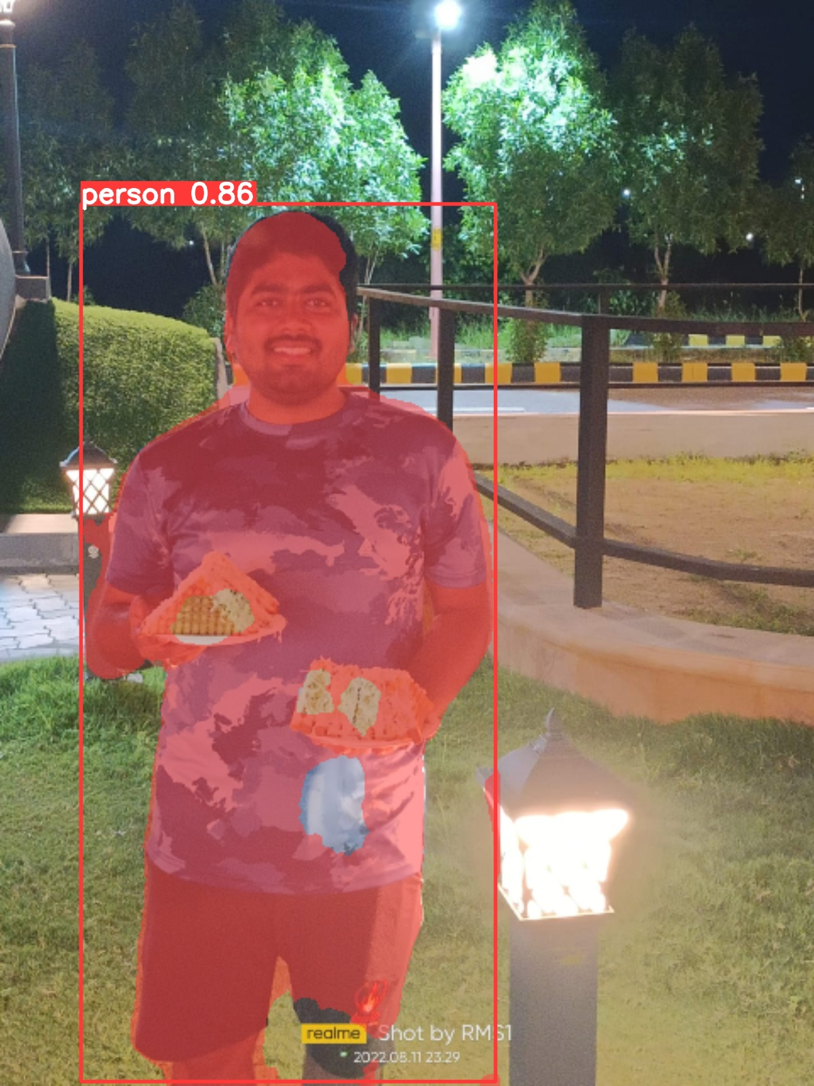
What is Semantic Segmentation?
Semantic segmentation is a CV task that is used to assign labels to every pixel in the image.The goal is to classify and label every pixel in the image according to the category or class it belongs to. This allows for a fine-grained understanding of the image, as each pixel is associated with a specific semantic meaning.
We try to separate a foreground and background from the image. For ex. In the below image a person is on the foreground of the image and the background is some other feature.

Slide 3
Methods Implemented:
We have tried to implement both classical and modern approaches i.e. Random forests, SVM’s for classical approach and CNN models such as YOLO v8 and U-Net.
In the subsequent slides we have demonstrated results from each methods we have implemented.

Slide 4
Classical approaches: Random Forest.
Data set used : Aerial images taken from web. Data set contains about 400 images taken from drone.
Random Forest is a popular machine learning algorithm used for both classification and regression tasks. It belongs to the ensemble learning methods, which combine multiple individual models to make more accurate predictions.
Some main features of random forest are : computational efficiency, seamless handling of features, inherent feature sharing of multiclass classifier.
Random forest uses decision trees for the classification tasks.

Slide 5
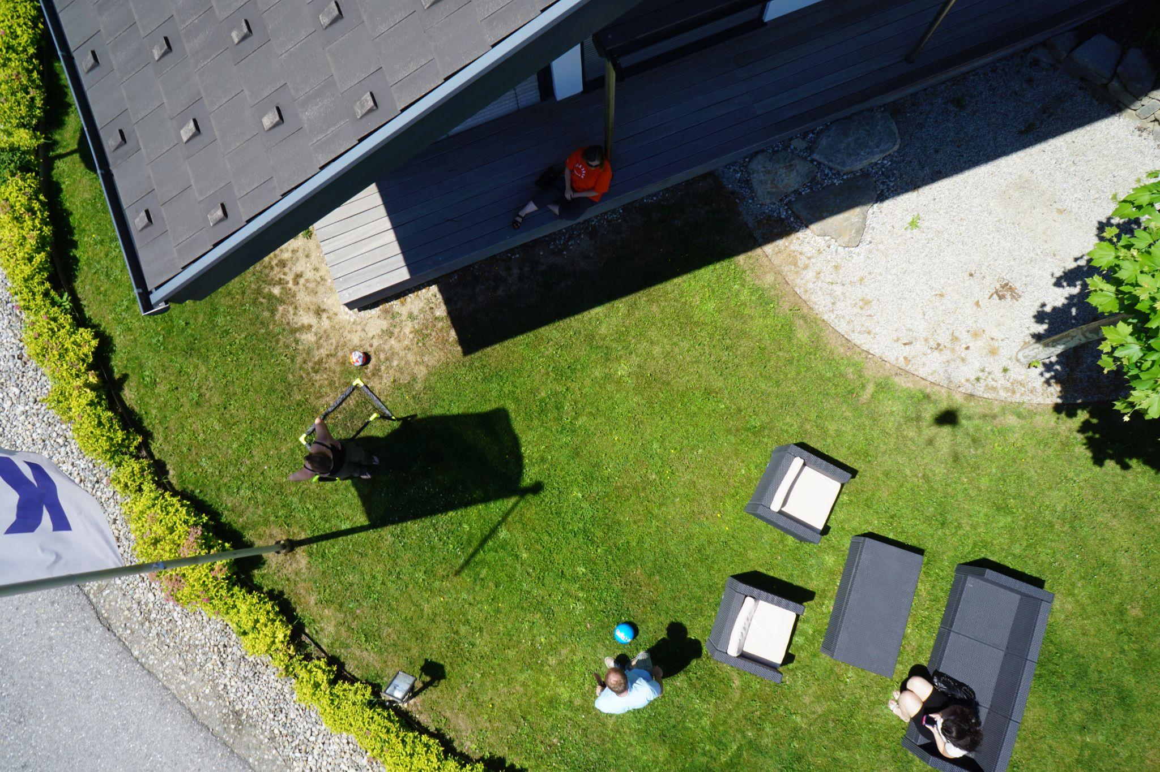
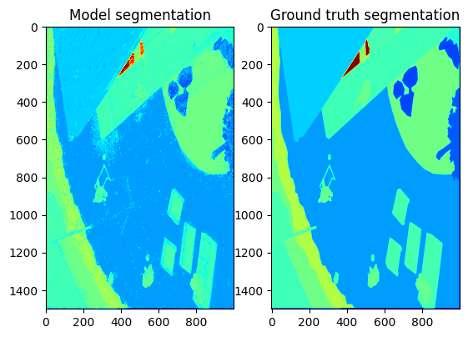
Results:
Accuracy of Random forest on aerial image dataset is: 80.68%

Slide 6
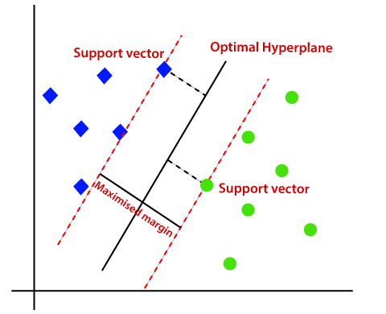
SVM: Support vector machine.
SVM is the one of the most popular supervised ML algorithms. It is used in as the classifier and in the regression task as well.
There can be linear or nonlinear SVM based on the hyperplane that we need.
For our implementation we have used linear SVM.
SVM defines a hyperplane of n-1 dimension, where n is the number of data dimension. And tries to maximize the margin to overcome misclassification.

Slide 7
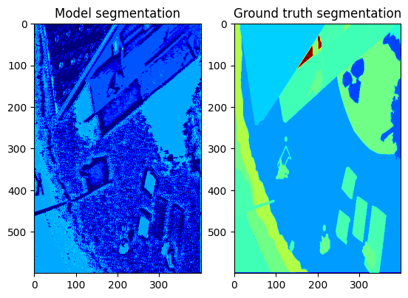
Results:
Accuracy on the aerial image dataset was 33.4%. The poor accuracy of SVM can be because there is no clear separation between the different classes and target classes are overlapping. Also we observed that during training we had to have some number of iteration and our hardware limitation.

Slide 8
YOLO v8:
YOLO: You Only Look Once is a CNN model widely used for the object detection and segmentation.
YOLO needs to have an pixel augmented data, where we need to give manual labels to each individual pixel which is a tedious task.
We have used YOLO v8 on COCO-128 dataset. The dataset consist of 80 labels including person, car, airplane, bottles etc.
We tested the model by using our own images taken inside and outside our campus.

Slide 9
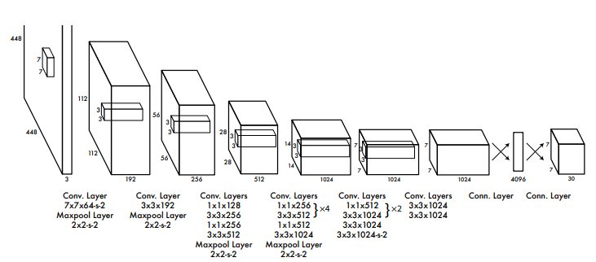
YOLO architecture:
Below we have shown YOLO architecture used in the original paper presented in CVPR-2016.

Slide 10
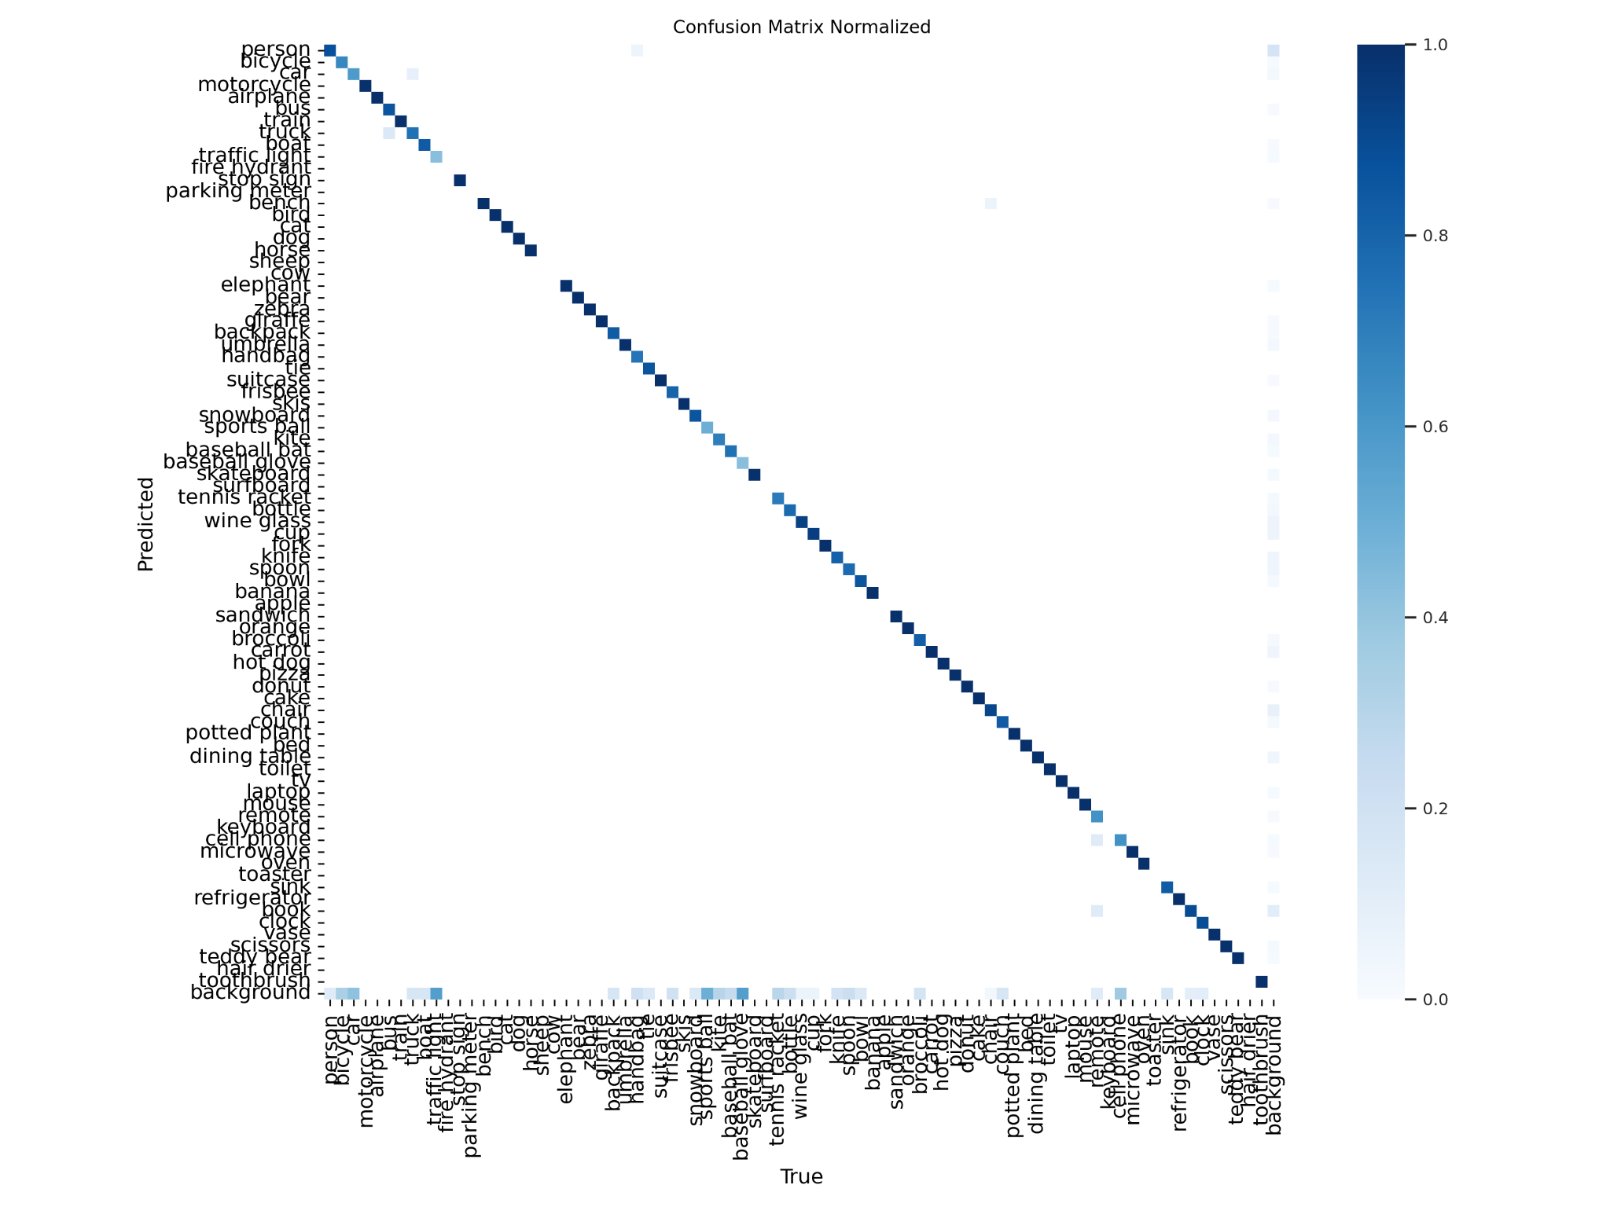
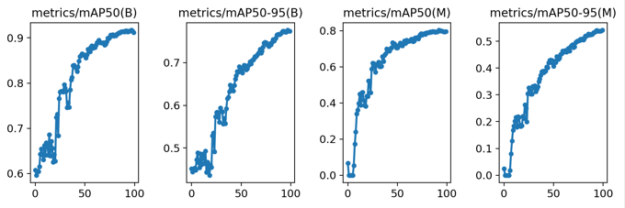
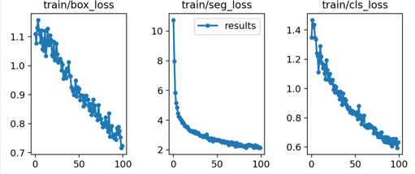
Results: Covariance matrix, mAP and training losses.
mAP and training loss
Covariance matrix

Slide 11
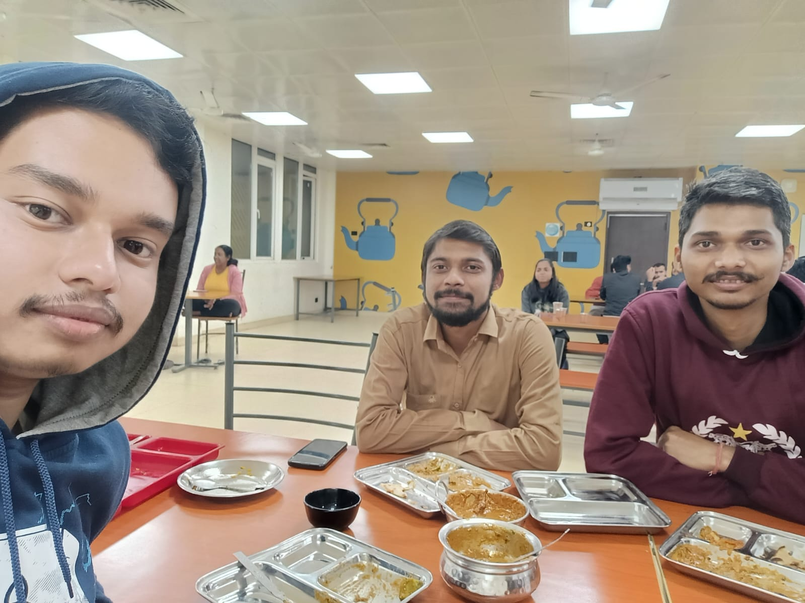
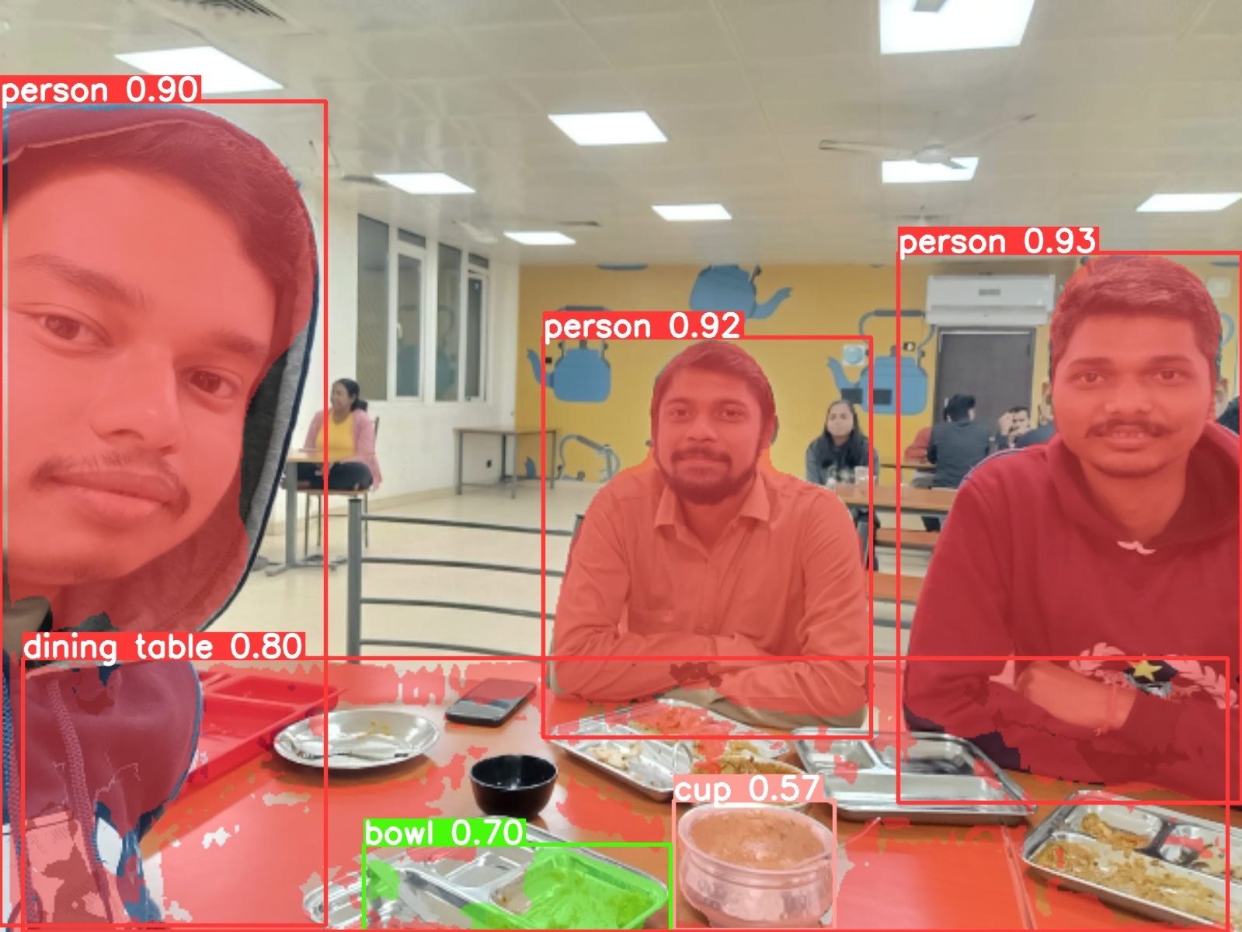
Results: Detection.

Slide 12
U-Net
U-Net is a popular CNN model for biomedical segmentation .It is a specific set of symmetric encoder-decoder instructions which is capable of semantic segmentation of images within seconds on a modern GPU.
We used U-Net on nuclei dataset available on web, which already had ground truth label.

Slide 13
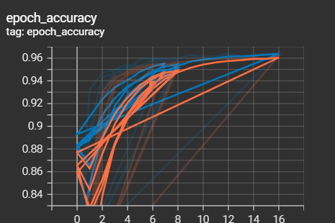
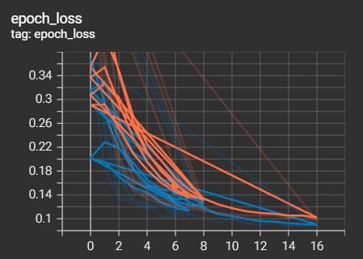
U-Net Metrics:
Here we can see the training accuracy and training loss for the dataset.

Slide 14
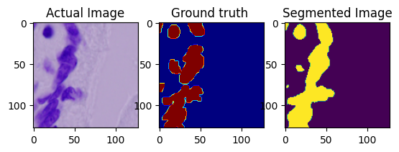
Results: Detection

Slide 15
Conclusion:
We have tried total of 4 different methods for semantic segmentation.
Two classical and two CNN based methods.
We feel that CNN based segmentation are easier to implement than classical methods. And their results are more compelling than traditional methods also.

Slide 16
Thank You :)

